Slide 1




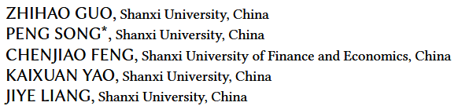





ATAI
Advanced Technique of Artificial Intelligence
ATAI
ChongqingUniversity _{AdvancedTechniqueof}
of Technology Artificial Intelligence
Chongqing University of
Technology
Chongqing University ^{ATAI}
_{of Technology} Advanced Techniqueof
Artificial Intelligence
Chongqing University of Technology
Chongqing University of Technology
Causal Inference for Multi-Criteria Rating Recommender Systems
——ACM TRANS_2025
Reported by Yuhang Jang
1
Notes:
Q1:认真的讲述一次，从头开始讲。
Q2：M->u 与U->m的区别

Slide 2
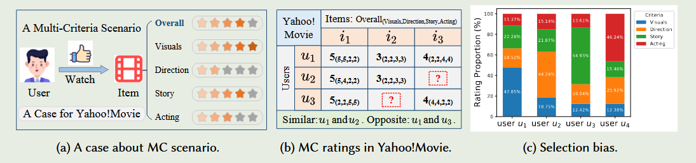
ATAI
Advanced Technique of Artificial Intelligence
ATAI
ChongqingUniversity _{AdvancedTechniqueof}
of Technology Artificial Intelligence
Chongqing University of
Technology
Chongqing University ^{ATAI}
_{of Technology} Advanced Techniqueof
Artificial Intelligence
Chongqing University of Technology
Chongqing University of Technology
Motivation
1) This single-criterion methods ignore the users’ multi-criteria (MC) behavioral characteristics.
2) Selection bias is pervasive in user behavior data. Traditional data-driven methods may induce spurious association and amplified biases.
Notes:
总评分怎么得到的? 其实中间的图片还可以说明使用多准则推荐可以发现两个总评分相等，但兴趣不同的情况。用户通常倾向于对他们喜欢或不喜欢的项目进行评分。这种自发行为可能导致典型的选择偏差。现有研究通常在拆分MC评级后引入传统的相似性度量，并通过聚合函数（如加权求和）实现预测

Slide 3
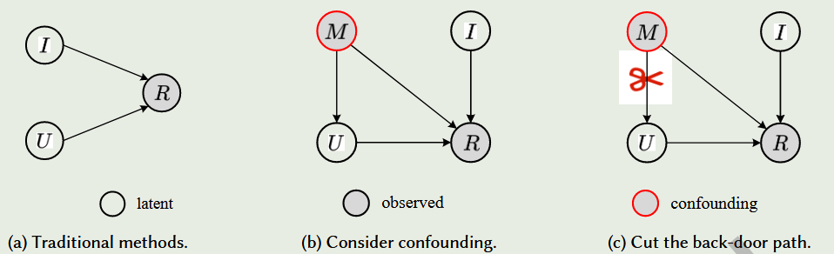
ATAI
Advanced Technique of Artificial Intelligence
ATAI
ChongqingUniversity _{AdvancedTechniqueof}
of Technology Artificial Intelligence
Chongqing University of
Technology
Chongqing University ^{ATAI}
_{of Technology} Advanced Techniqueof
Artificial Intelligence
Chongqing University of Technology
Chongqing University of Technology
Method
Notes:
U跟R并不是直接关联，因为R是多个准则评分算出来的，U与R中间是含有M，形成一个伪关联，当M出现问题，会导致预测不准。切断M到U是因为R是直接被M影响的 R：{R0, R1, . . . , RK }, M：1*K，这个1主要看user的数量。
得到两个解法：（1）为了解决M的偏好缺少 对于M取平均值
（2）为了解决M影响U的学习表征

Slide 4
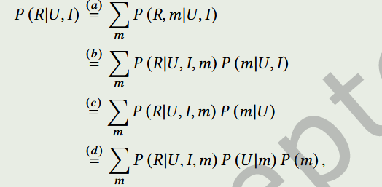
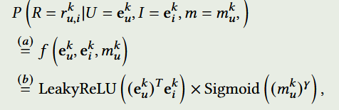
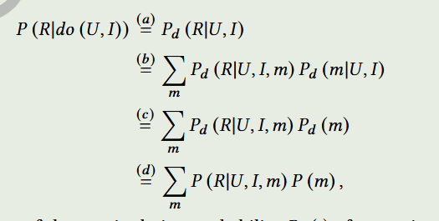
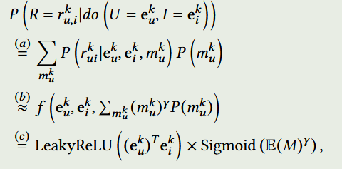
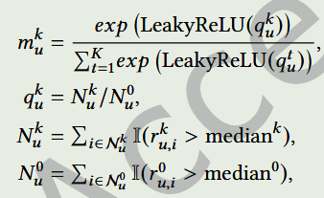
ATAI
Advanced Technique of Artificial Intelligence
ATAI
ChongqingUniversity _{AdvancedTechniqueof}
of Technology Artificial Intelligence
Chongqing University of
Technology
Chongqing University ^{ATAI}
_{of Technology} Advanced Techniqueof
Artificial Intelligence
Chongqing University of Technology
Chongqing University of Technology
Method

Slide 5
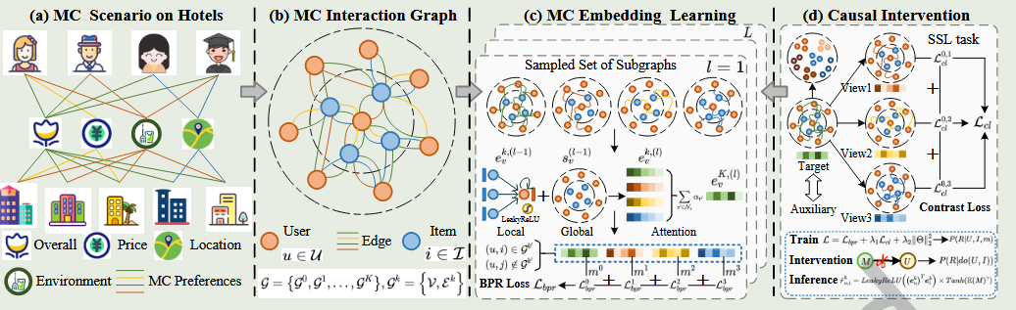
ATAI
Advanced Technique of Artificial Intelligence
ATAI
ChongqingUniversity _{AdvancedTechniqueof}
of Technology Artificial Intelligence
Chongqing University of
Technology
Chongqing University ^{ATAI}
_{of Technology} Advanced Techniqueof
Artificial Intelligence
Chongqing University of Technology
Chongqing University of Technology
Method
Notes:
SSL可以应对数据稀少的时候，同时要让局部embedding，更进一步的了解K个局部embedding的特点。

Slide 6




ATAI
Advanced Technique of Artificial Intelligence
ATAI
ChongqingUniversity _{AdvancedTechniqueof}
of Technology Artificial Intelligence
Chongqing University of
Technology
Chongqing University ^{ATAI}
_{of Technology} Advanced Techniqueof
Artificial Intelligence
Chongqing University of Technology
Chongqing University of Technology
Method
Notes:
Bpr损失：用用户交互过-用户没有交互过的

Slide 7





ATAI
Advanced Technique of Artificial Intelligence
ATAI
ChongqingUniversity _{AdvancedTechniqueof}
of Technology Artificial Intelligence
Chongqing University of
Technology
Chongqing University ^{ATAI}
_{of Technology} Advanced Techniqueof
Artificial Intelligence
Chongqing University of Technology
Chongqing University of Technology
Method
Notes:
Bpr损失：用用户交互过-用户没有交互过的

Slide 8

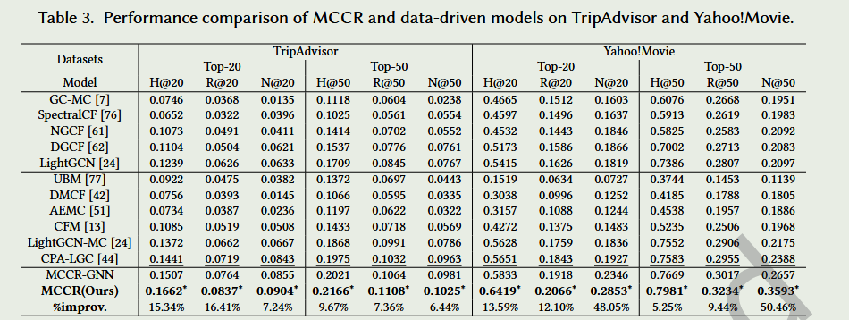
ATAI
Advanced Technique of Artificial Intelligence
ATAI
ChongqingUniversity _{AdvancedTechniqueof}
of Technology Artificial Intelligence
Chongqing University of
Technology
Chongqing University ^{ATAI}
_{of Technology} Advanced Techniqueof
Artificial Intelligence
Chongqing University of Technology
Chongqing University of Technology

Slide 9
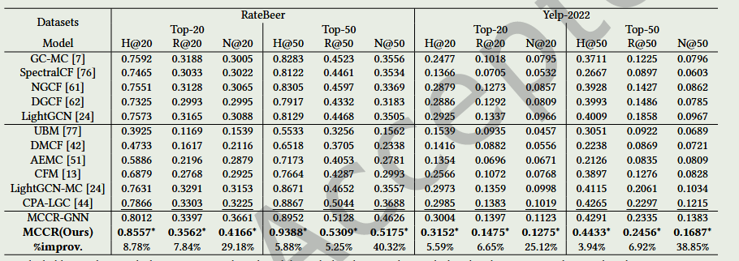
ATAI
Advanced Technique of Artificial Intelligence
ATAI
ChongqingUniversity _{AdvancedTechniqueof}
of Technology Artificial Intelligence
Chongqing University of
Technology
Chongqing University ^{ATAI}
_{of Technology} Advanced Techniqueof
Artificial Intelligence
Chongqing University of Technology
Chongqing University of Technology

Slide 10
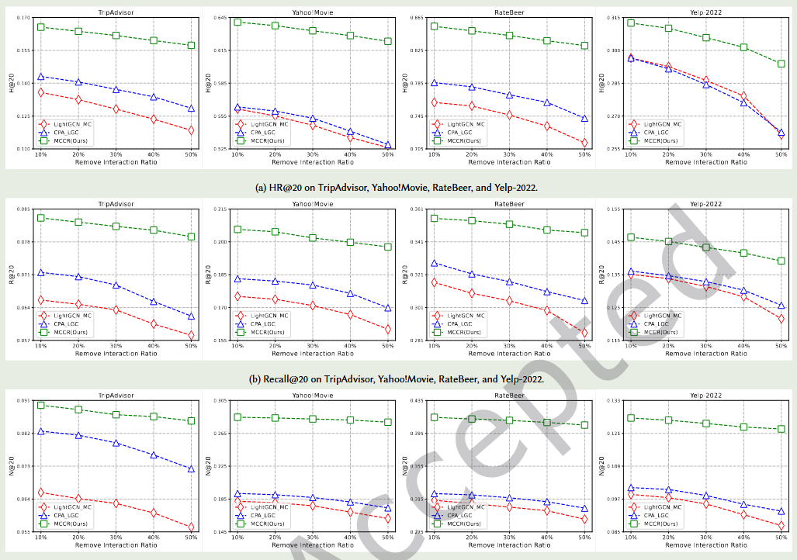
ATAI
Advanced Technique of Artificial Intelligence
ATAI
ChongqingUniversity _{AdvancedTechniqueof}
of Technology Artificial Intelligence
Chongqing University of
Technology
Chongqing University ^{ATAI}
_{of Technology} Advanced Techniqueof
Artificial Intelligence
Chongqing University of Technology
Chongqing University of Technology
Notes:
人为的进行移除数据，按照上面的概率，也相当于充当选择偏差，或者制造偏差

Slide 11
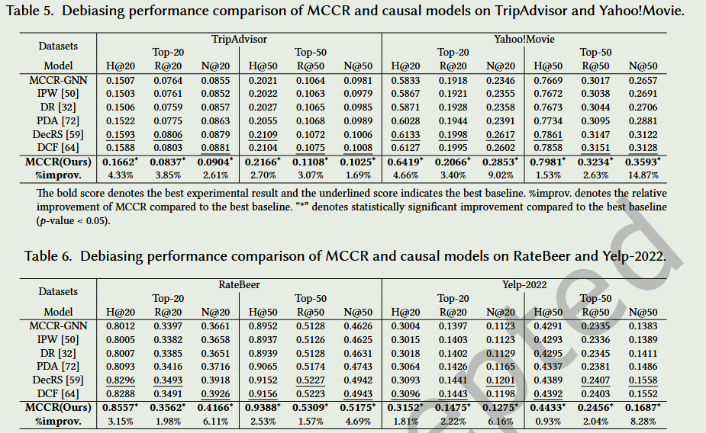
ATAI
Advanced Technique of Artificial Intelligence
ATAI
ChongqingUniversity _{AdvancedTechniqueof}
of Technology Artificial Intelligence
Chongqing University of
Technology
Chongqing University ^{ATAI}
_{of Technology} Advanced Techniqueof
Artificial Intelligence
Chongqing University of Technology
Chongqing University of Technology
Notes:
分别是2016年前面前两个、2021 2021 2020

Slide 12
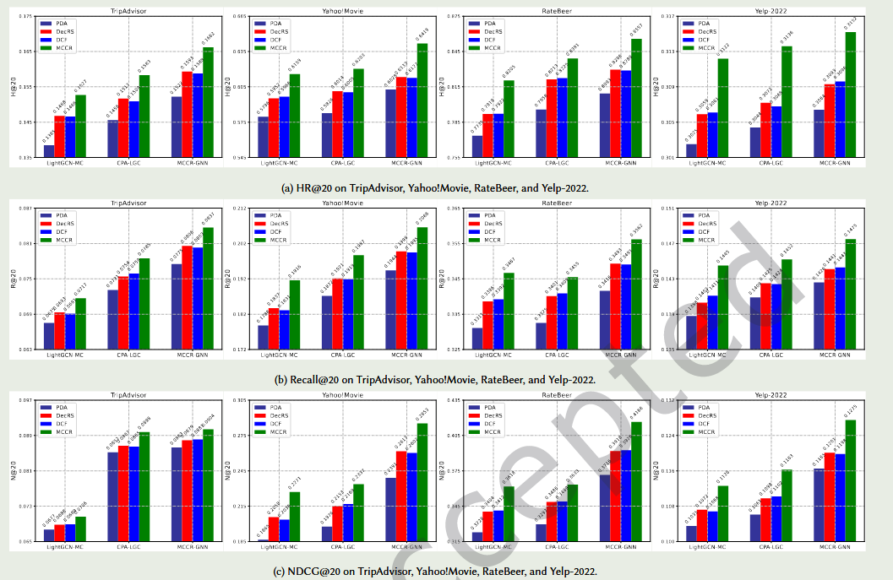
ATAI
Advanced Technique of Artificial Intelligence
ATAI
ChongqingUniversity _{AdvancedTechniqueof}
of Technology Artificial Intelligence
Chongqing University of
Technology
Chongqing University ^{ATAI}
_{of Technology} Advanced Techniqueof
Artificial Intelligence
Chongqing University of Technology
Chongqing University of Technology
Notes:
PDA：把用户–物品的交互分解为不同 criterion 的偏好，再聚合成总偏好。（2019）
DCF：用深度神经网络建模多个 criterion 的评分，并共享潜在因子。（2018）
DECRS：结合显式（criterion-specific）和共享（collective）表示，用深度结构同时捕捉局部与全局信息。（2020）

Slide 13
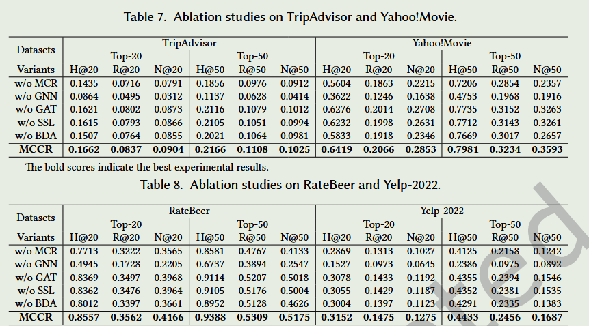
ATAI
Advanced Technique of Artificial Intelligence
ATAI
ChongqingUniversity _{AdvancedTechniqueof}
of Technology Artificial Intelligence
Chongqing University of
Technology
Chongqing University ^{ATAI}
_{of Technology} Advanced Techniqueof
Artificial Intelligence
Chongqing University of Technology
Chongqing University of Technology
Notes:
MCR：只保留总评分
GNN：不适用图卷积网络构建embedding
BDA：不用后门操作，train与inference采用同一个公式
GAT：衡量关联程度的系数，改成么给k平等

Slide 14
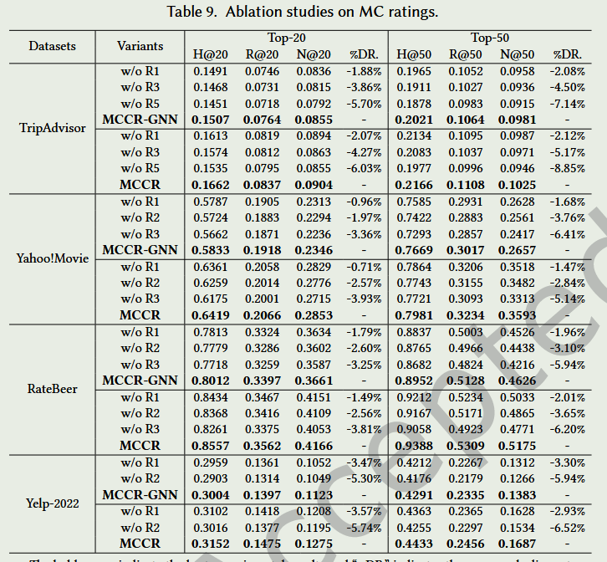
ATAI
Advanced Technique of Artificial Intelligence
ATAI
ChongqingUniversity _{AdvancedTechniqueof}
of Technology Artificial Intelligence
Chongqing University of
Technology
Chongqing University ^{ATAI}
_{of Technology} Advanced Techniqueof
Artificial Intelligence
Chongqing University of Technology
Chongqing University of Technology

Slide 15
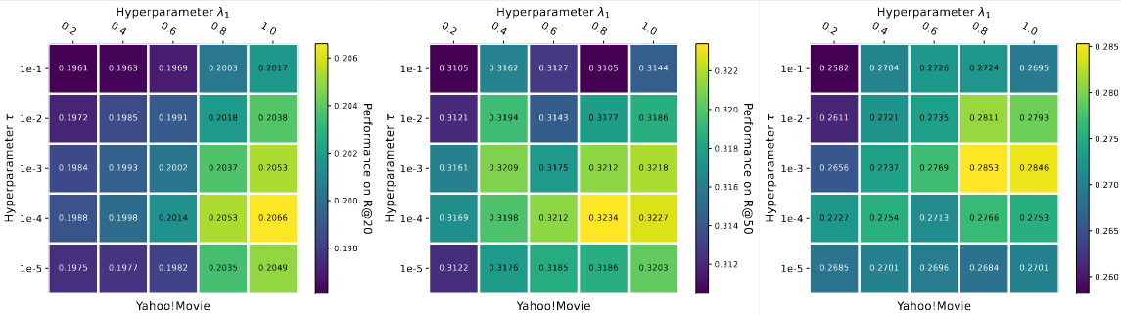
ATAI
Advanced Technique of Artificial Intelligence
ATAI
ChongqingUniversity _{AdvancedTechniqueof}
of Technology Artificial Intelligence
Chongqing University of
Technology
Chongqing University ^{ATAI}
_{of Technology} Advanced Techniqueof
Artificial Intelligence
Chongqing University of Technology
Chongqing University of Technology

Slide 16
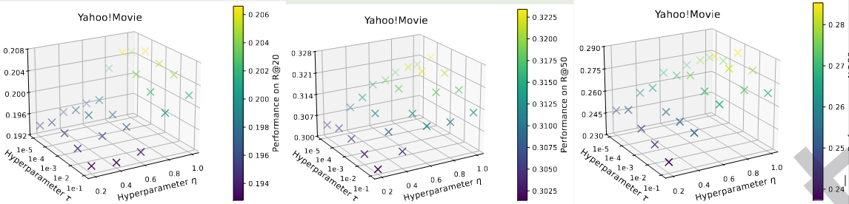
ATAI
Advanced Technique of Artificial Intelligence
ATAI
ChongqingUniversity _{AdvancedTechniqueof}
of Technology Artificial Intelligence
Chongqing University of
Technology
Chongqing University ^{ATAI}
_{of Technology} Advanced Techniqueof
Artificial Intelligence
Chongqing University of Technology
Chongqing University of Technology

Slide 17
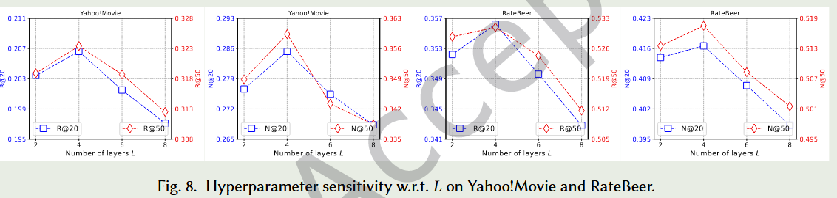
ATAI
Advanced Technique of Artificial Intelligence
ATAI
ChongqingUniversity _{AdvancedTechniqueof}
of Technology Artificial Intelligence
Chongqing University of
Technology
Chongqing University ^{ATAI}
_{of Technology} Advanced Techniqueof
Artificial Intelligence
Chongqing University of Technology
Chongqing University of Technology

Slide 18
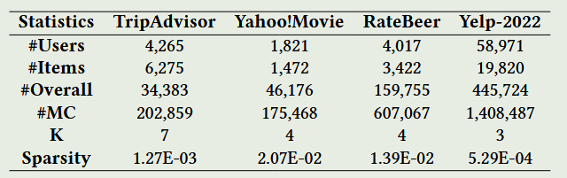

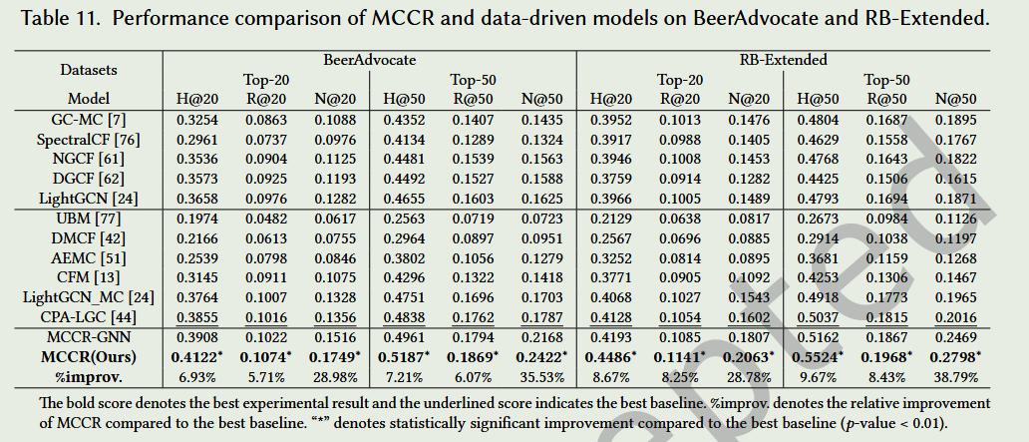
ATAI
Advanced Technique of Artificial Intelligence
ATAI
ChongqingUniversity _{AdvancedTechniqueof}
of Technology Artificial Intelligence
Chongqing University of
Technology
Chongqing University ^{ATAI}
_{of Technology} Advanced Techniqueof
Artificial Intelligence
Chongqing University of Technology
Chongqing University of Technology

Slide 19
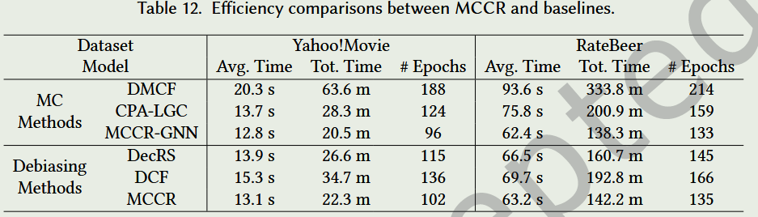
ATAI
Advanced Technique of Artificial Intelligence
ATAI
ChongqingUniversity _{AdvancedTechniqueof}
of Technology Artificial Intelligence
Chongqing University of
Technology
Chongqing University ^{ATAI}
_{of Technology} Advanced Techniqueof
Artificial Intelligence
Chongqing University of Technology
Chongqing University of Technology

Slide 20


ATAI
Advanced Technique of Artificial Intelligence
ATAI
ChongqingUniversity _{AdvancedTechniqueof}
of Technology Artificial Intelligence
Chongqing University of
Technology
Chongqing University ^{ATAI}
_{of Technology} Advanced Techniqueof
Artificial Intelligence
Chongqing University of Technology
Chongqing University of Technology
Thanks!

